Slide 1
Lighter & Faster Semantic Segmentation by Post-Training Quantization & Quantization-Aware Training
SJSU CS 256 GroupE
Anand Vishwakarma, Inhee Park, Sagar Shahi, Sherif Elsaid, Sriram Priyatham

Slide 2
Overview

Slide 3
Overview
Computer Vision Topic -- Semantic Segmentation
Hard problem: object detection + multi-classification at pixel level
Segmentation Framework -- DeepLabV3+
Atrous convolution (faster)
Encoder-Decoder (shaper boundary)
Backbone Architecture -- MobileNetV2
Depthwise-separable-convolution + Inverted-Residual-Layer
TFLite for Mobile & IoT
Project Task -- Quantization
Quantization makes DeepLabV3+ on MobileNetV2 more lighter and faster

Slide 4
Overview
Quantization Approach 1 -- Post-Training-Quantization
F32 model prep -> Quantize
Quantization Approach 2 -- Quantization-Aware-Training
F32 model prep -> Quantize
Inference and Evaluation with Demo (Quantization & Inference Script on Colab)
Comparison between F32 vs. 8-bit integer inferences

Slide 5
Computer Vision Topic -- Semantic Segmentation
=> Hard problem: object detection + multi-classification at pixel level

Slide 6
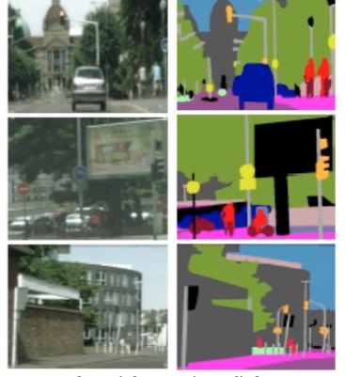
Semantic Segmentation
Understanding the image at pixel level
Partitioning the image into regions of meaningful objects
Assign a category label to each object

Slide 7
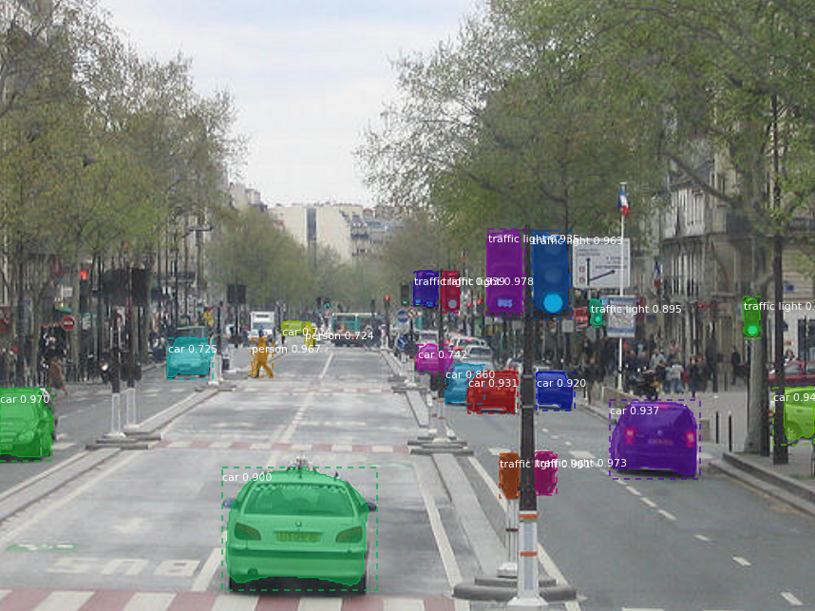
Applications
Self driving cars
Medical imaging
Photography - spoilers ! -

Slide 8
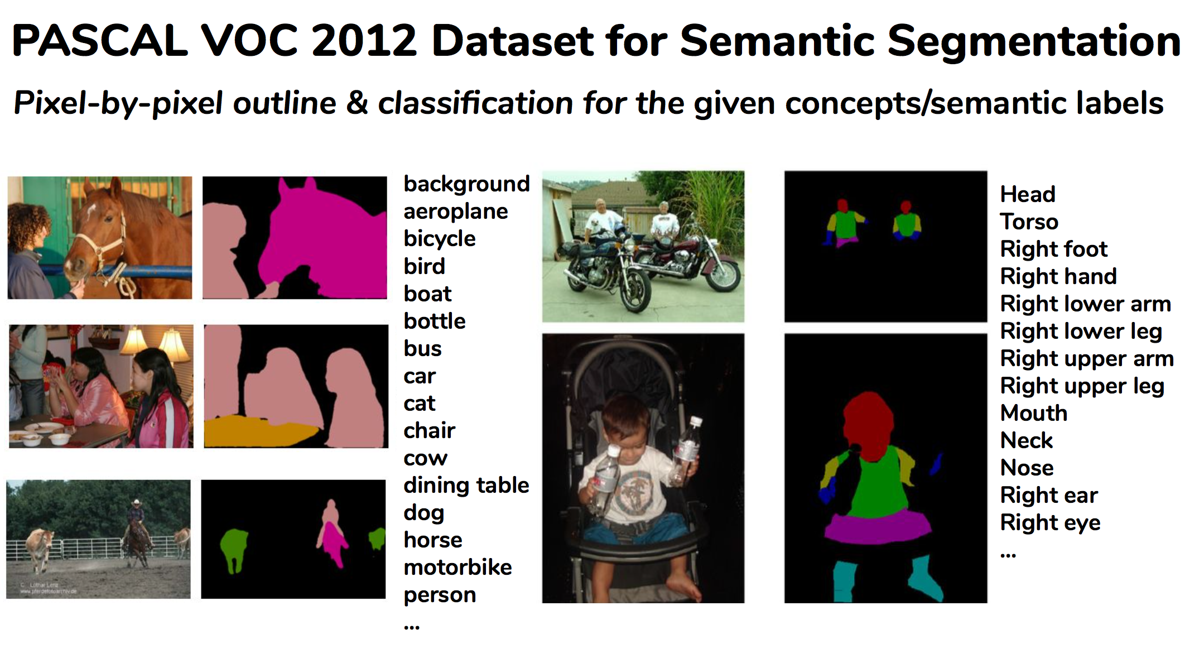
Semantic Segmentation Requires
pinpointing the outline of objects
Imposing much stricter localization accuracy than image-level classification
Conv layers with downsampling and upsampling

Slide 9
Introduction
Machine Learning at the Edge
Increasing need for running the prediction and ML models at various edge devices
Nature of the edge devices provides a constraint on both compute and memory
Large Models are harder to distribute to edge devices
Neural Networks are getting larger and more complex
Training ML models is a time and compute intensive task
Training ML models is inefficient in terms of energy consumption and overall cost

Slide 10
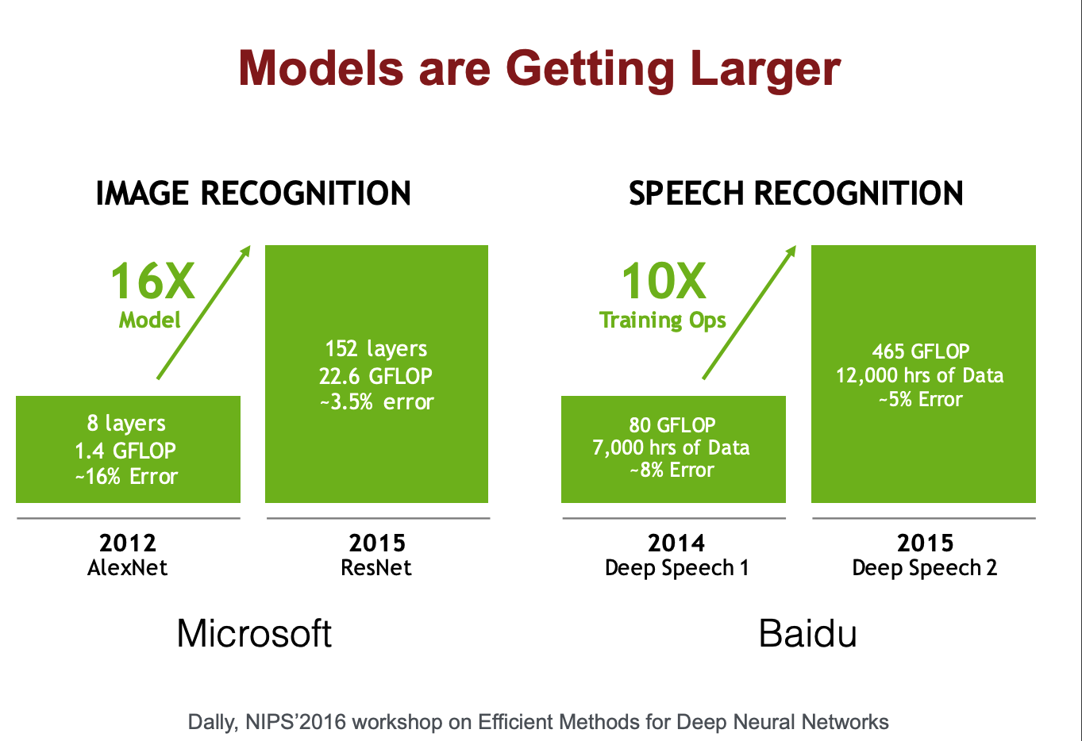
Trends
Model sizes getting larger
Computationally expensive
Energy in-efficient

Slide 11
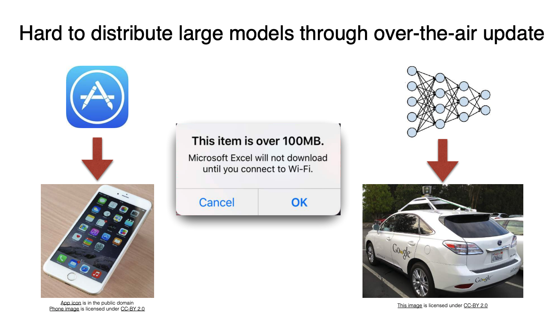
Challenges
Distribution
Inference time
Memory restriction

Slide 12
Methods for Improving Efficiency of Deep Learning
Improve the Hardware doing the training and running the models
Faster CPUs & GPUs
Use specialized hardware for machine learning (Ex: FPGAs)
Improve the efficiency of the algorithms responsible for training and predicting the machine learning models
Use Model compression techniques

Slide 13
Model Compression Techniques
Quantization
Weight sharing
Pruning
Architecture design
Knowledge Distillation
Others (low rank approximation, winograd transformation, ...etc)

Slide 14
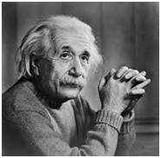
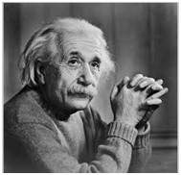
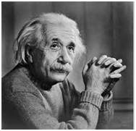
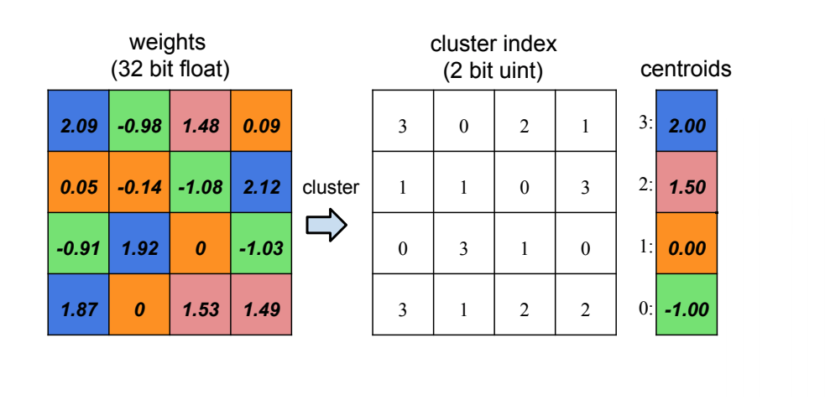

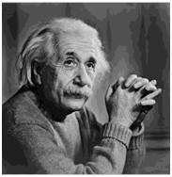
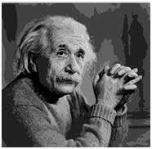
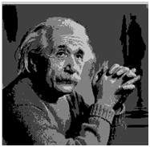
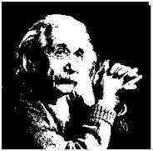
Quantization
Weight Sharing
Convert Higher precision to Lower precision
Example 256 bits per pixel to 2 bits per pixel
Non-linear quantization
Represent weights as their approximate integer values (2.03, 1.89 → 2)
Share the same weights using cluster index

Slide 15
Objective
Using various quantization techniques and by adjusting and experimenting with the different hyperparameters, both during and after the training, we aimed to produce a tensorflow quantized model with comparable accuracy, smaller size, and faster inference time, than the models provides as an example by the original deeplab team.

Slide 16
Networks Choice
We choose to carry out our research using “MobileNet v2” as the backbone network due to its excellent performance and benchmarks on a variety of tasks and the small size and lower latency of its produced models, For the decoder network, we choose to use DeepLab v3+ that’s being developed and maintained by google, it has a proven track record, and is the technology behind some of the advancement on google’s pixel smartphone photography in recent years.

Slide 17
Datasets
Pascal VOC dataset -the main dataset for the majority of the research-
Cityscapes dataset -experimented with it for quantization aware training and inference-
ADE20K dataset -used briefly for running inference-

Slide 18
Details
VOC 2012 dataset
CityScapes dataset
DeepLab V3+ Decoder Network
MobileNet v2 Encoder Network
TensorFlow 1.15
TensorFlow lite
p2.xLarge ec2 instance
Deep Learning AMI with Ubuntu 16

Slide 19
2. Segmentation Framework -- DeepLabV3+
=> Atrous convolution (faster)
=> Encoder-Decoder (shaper feature extraction)
=> Spatial Pyramid Pooling

Slide 20
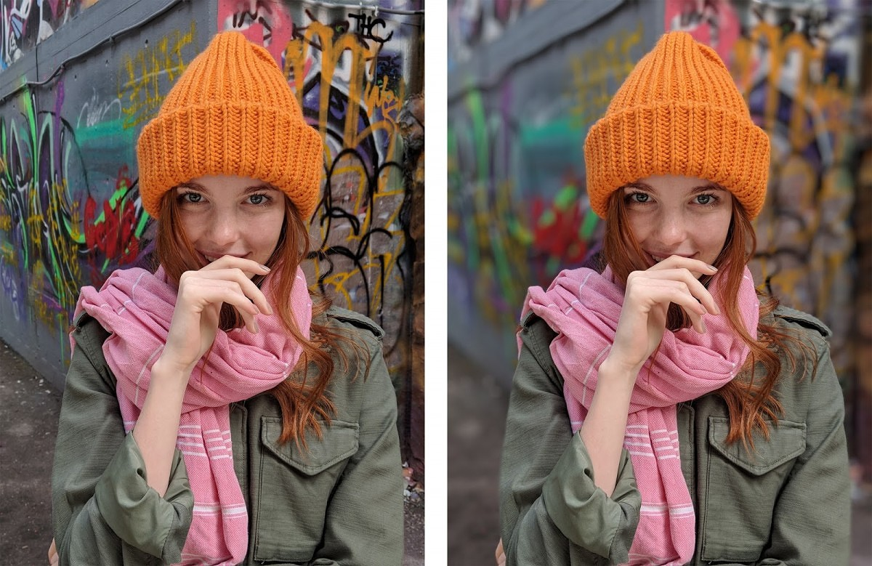
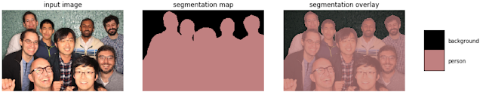
Background
Shallow depth of field effect
Separating foreground (person) from background
Example: portrait mode in Pixel phones

Slide 21
History
Close to 4 years of development
Only recently open sourced (2016)
Currently at version deeplab v3+
Particularly useful for semantic segmentation

Slide 22
Available backbone networks
MobileNetv2 and MobileNetv3 : A fast network structure designed for mobile devices.
Xception : A powerful network structure intended for server-side deployment.
ResNet-v1-{50,101} : We provide both the original ResNet-v1 and its 'beta' variant where the 'stem' is modified for semantic segmentation.
PNASNet : A Powerful network structure found by neural architecture search.
Auto-DeepLab : A segmentation-specific network backbone found by neural architecture search.

Slide 23
Architecture
Encoder
Uses a pre-trained CNN to extract the essential information
Depthwise separable convolution instead of max pooling
Extra batch normalization and Relu
Decoder
Reconstrct output (segmentation mask)
Uses ASPP
Bilinear upsampling to get the correct spatial dimension

Slide 24
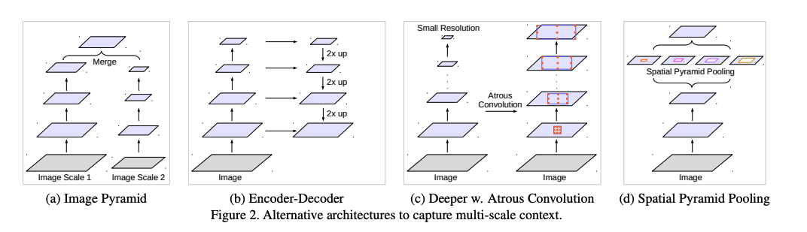
Main Challenge: Objects at multiple scales (sizes)

Slide 25
Spatial pyramid pooling
Capture context at several ranges
I.e: multiple scaled versions of the input
Parallel atrous convolution layers with different rates capture multi-scale information
I.e: parallel versions of the same network training at different scales, then combined into one feature
atrous spatial pyramid pooling (ASPP)
Efficient computational complexity
Larger field of view using same number of parameters as traditional convolution

Slide 26

Traditional Convolution
2D convolution using a kernel size of 3, stride of 1 and padding of 1

Slide 27

Atrous Convolution
(Dilated Convolutions)
2D convolution using a kernel size of 3, stride of 1, no padding, and an extra dilation rate of 2

Slide 28
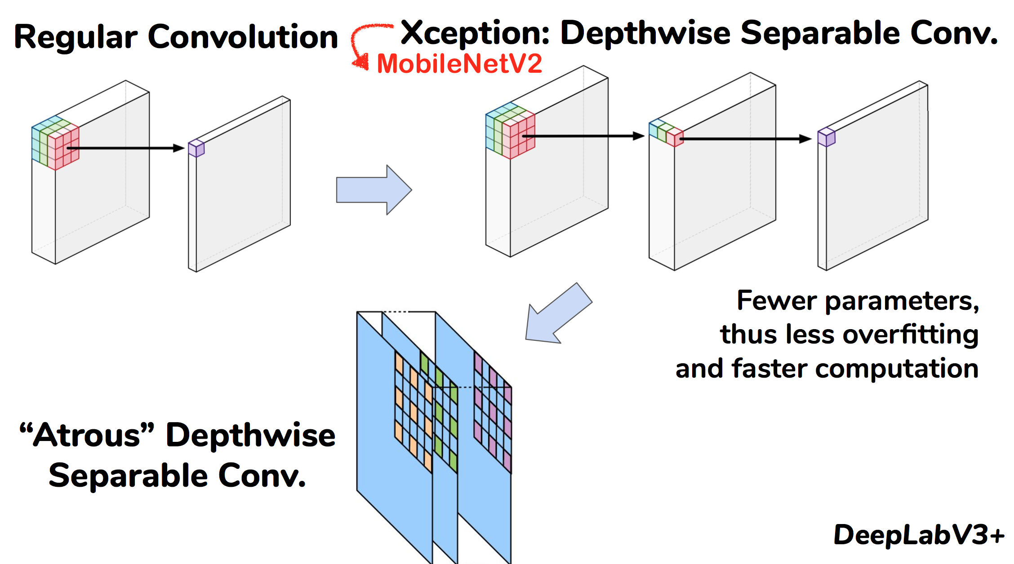
Faster “Atrous Depthwise Separable” Conv. on MobileNetV2
Depthwise Convolution -> fewer parameters
Pointwise Convolution -> more channels

Slide 29
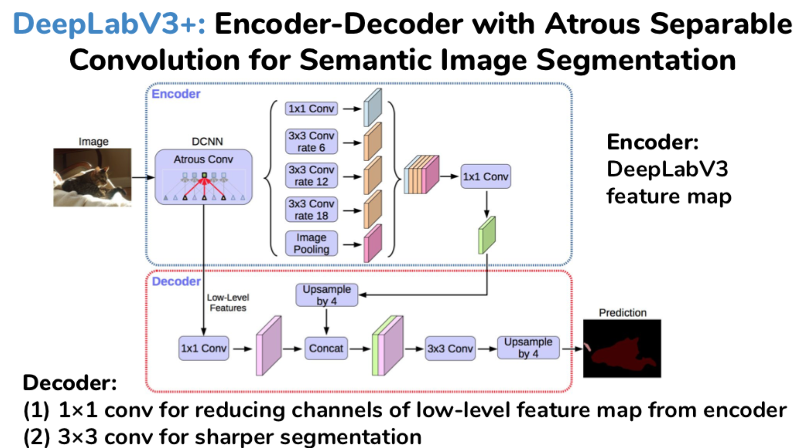
Sharper Boundary Segmentation by Encoder-Decoder
Extra decoder module to refine the segmentation results especially along object boundaries
Applying depthwise separable convolution to both ASPP and decoder modules, resulting in a faster and stronger encoder-decoder network for semantic segmentation

Slide 30
3. Backbone Architecture -- MobileNetV2
=> Depthwise-separable-convolution + Inverted-Residual-Layer; TFLite for Mobile & IoT

Slide 31
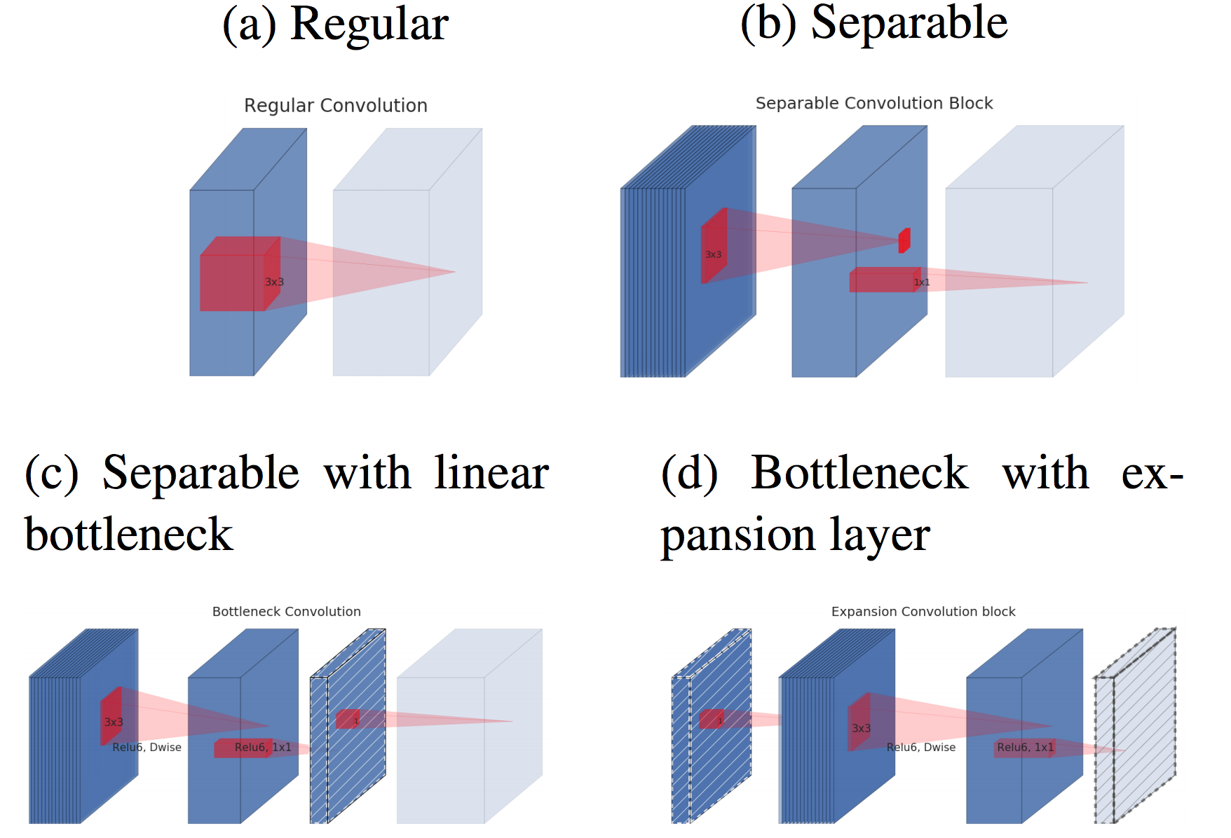
MobileNetV2: Depthwise-Separable-Conv + Inverted-Residual Layer

Slide 32
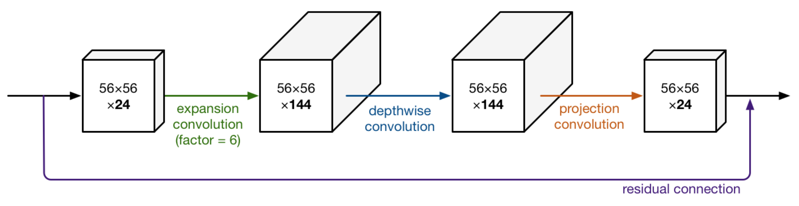
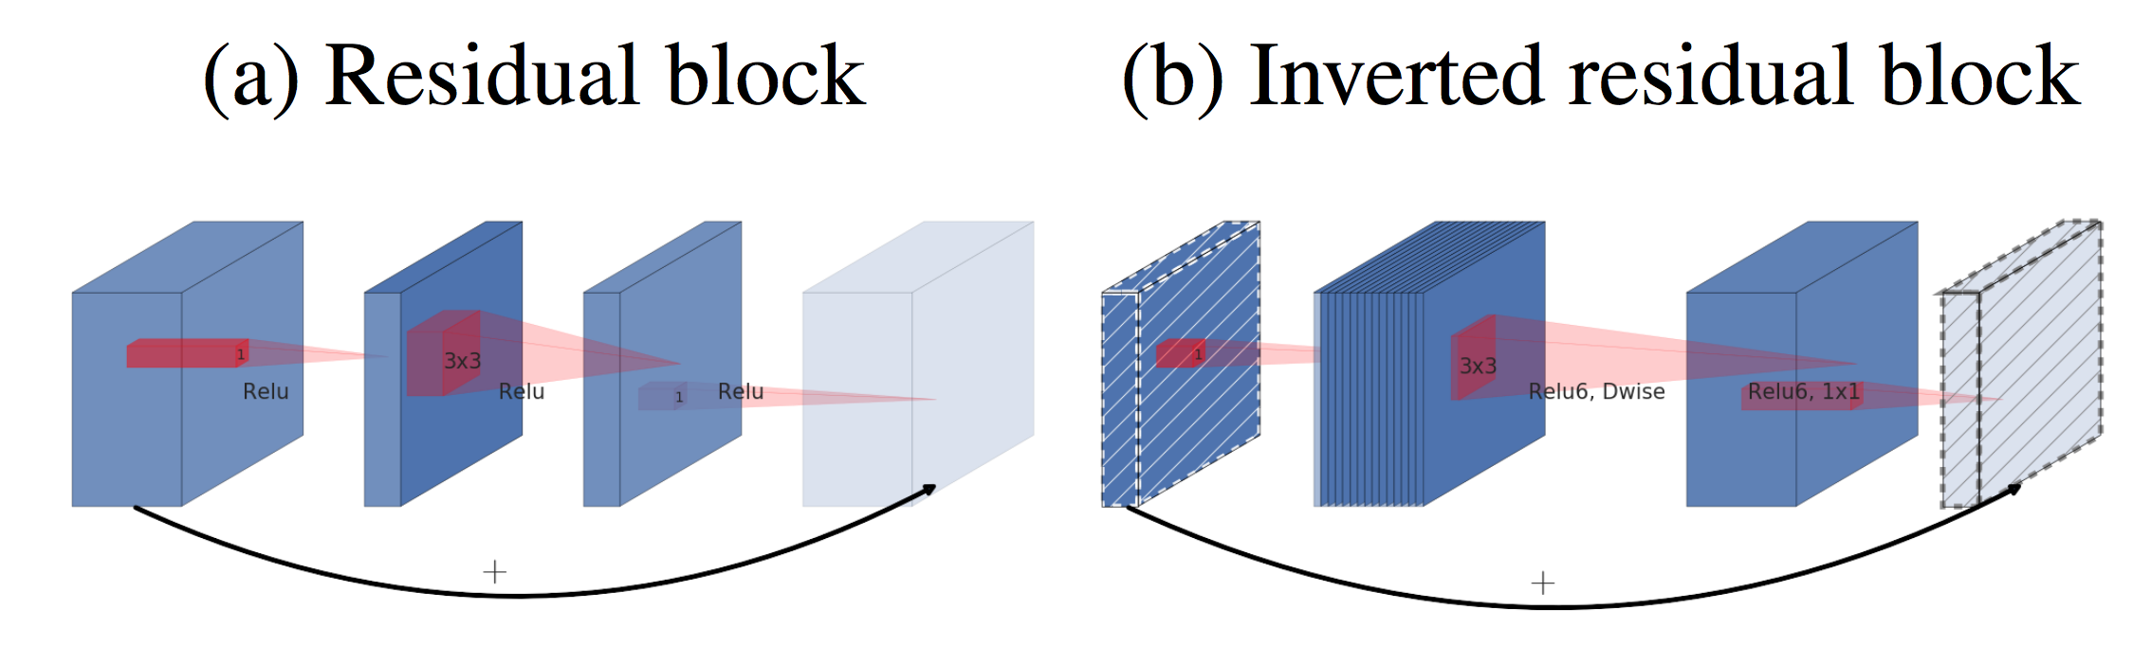
MobileNetV2:
1) Depthwise-Separable-Conv
Like DeepLabV3+
2) Inverted-Residual Layer
Like ResNet but Expansion

Slide 33
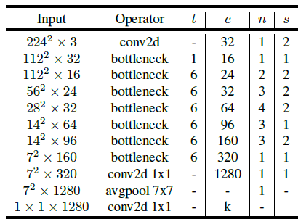
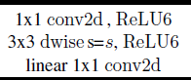
MobileNetV2
All layers
Residual block layer

Slide 34
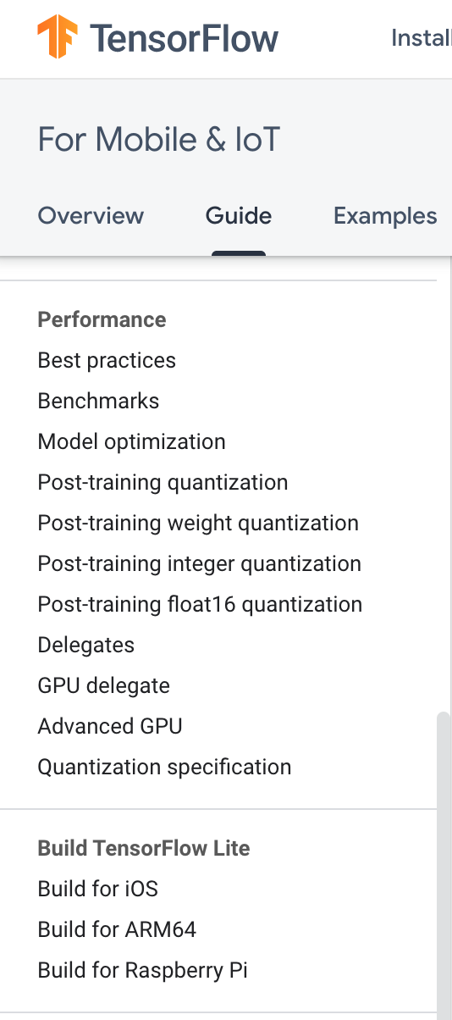
MobileNetV2
using TensorFlow Lite for
Mobile & IoT

Slide 35
4. Project Task -- Quantization
=> Quantization makes DeepLabV3+ on MobileNetV2 more lighter and faster

Slide 36
Fixed Point, Per-Tensor Quantization in TensorFlow
First find the range of values in our tensor. The range we use is always centered on 0, so we find m such that
m = max(abs(input_min), abs(input_max))
Our input tensor range is then [-m, m]
Next, we choose our fixed-point quantization buckets, [min_fixed, max_fixed].
With input tensor T, num_bits = sizeof(T) * 8
If T is unsigned, the fixed-point range is
[min_fixed, max_fixed] = [0, 2^(num_bits) - 1]
From this we compute our scaling factor,
s = (max_fixed - min_fixed) / (2 * m)
Now we can quantize the elements of our tensor
result = round(input * s)

Slide 37
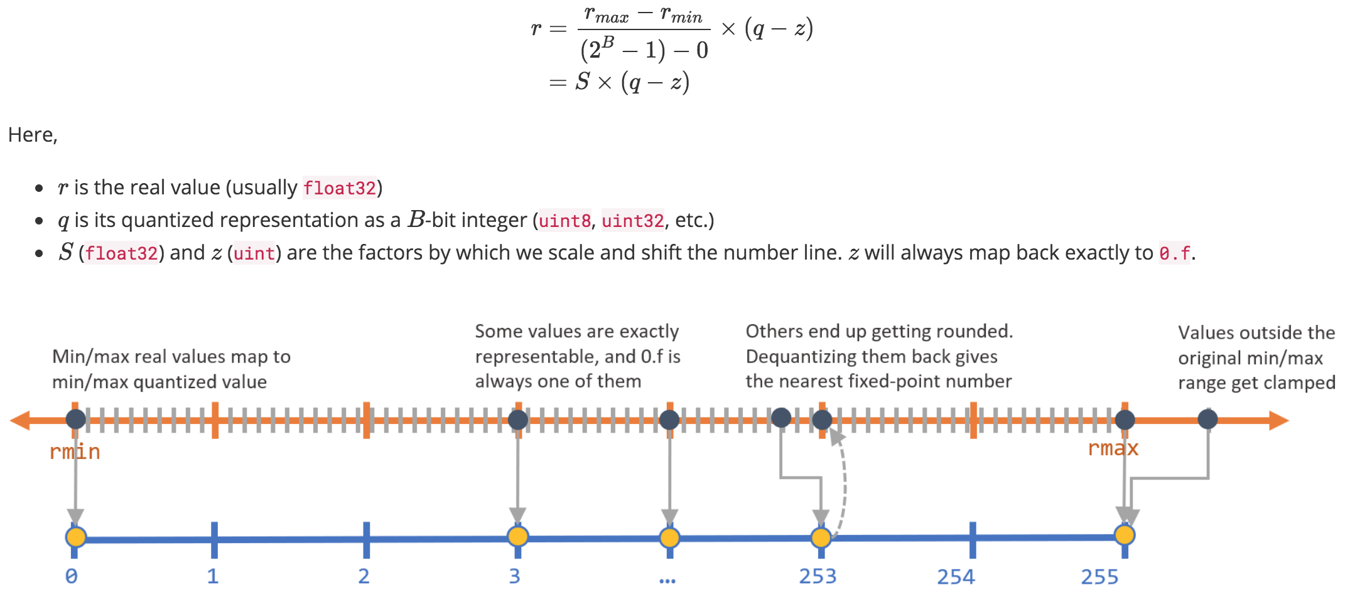
Fixed Point Quantization implemented in TensorFlow
q = (r/S) + z

Slide 38
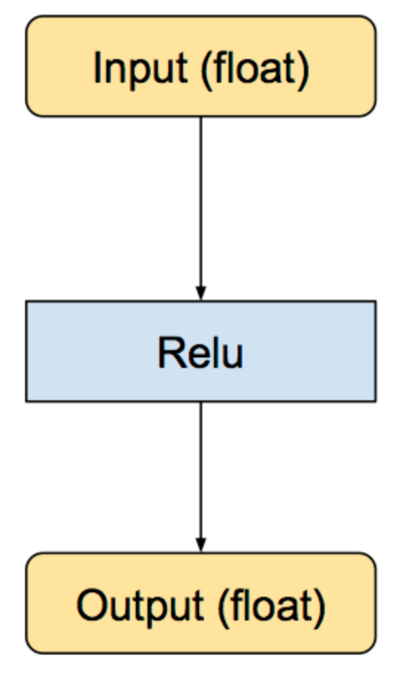
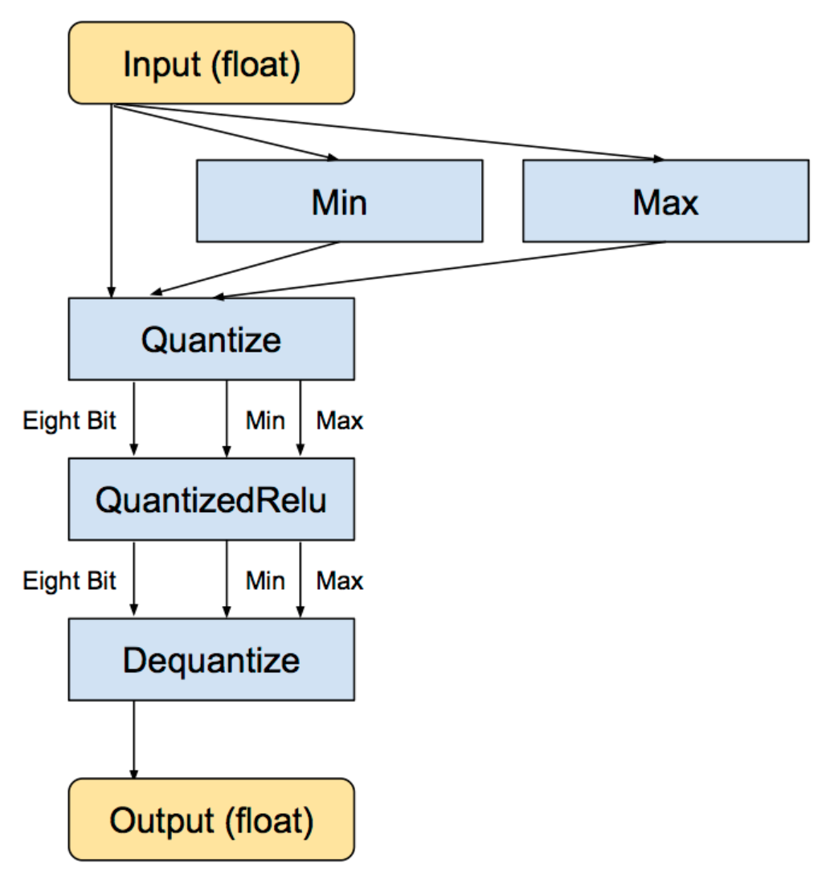
Fixed Point Quantization implemented in TensorFlow
equivalent converted subgraph, still with float inputs and outputs, but with internal conversions so the calculations are done in eight bit.

Slide 39
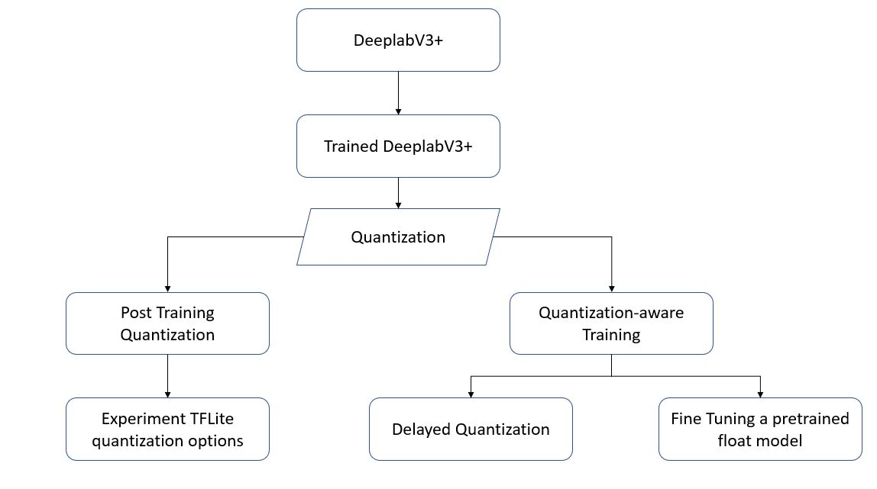
Quantization Experiments

Slide 40
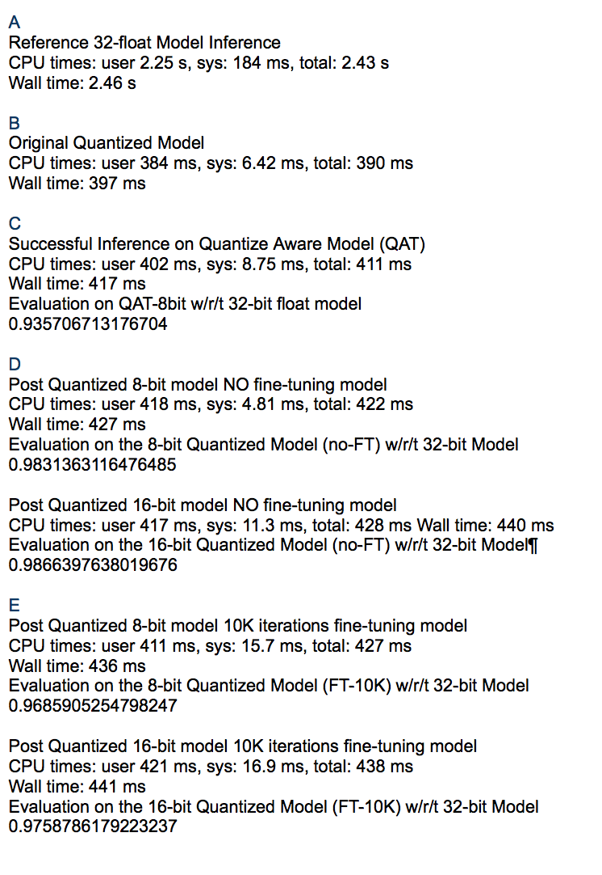
Overview of
Our Quantization Evaluation

Slide 41
5. Quantization Approach 1 --
Post-Training-Quantization
=> F32 model prep -> Quantize

Slide 42
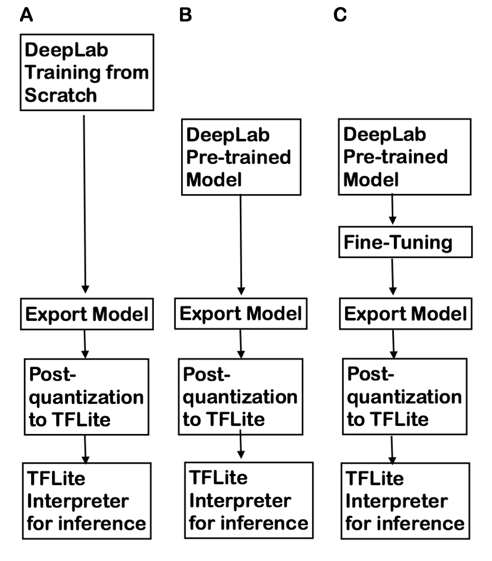
Post-Training-Quantization
WorkFlow
Train from scratch
No Fine-tuning
Fine-tuning
w/ 1, 10, 100, 1K, 10K iterations

Slide 43
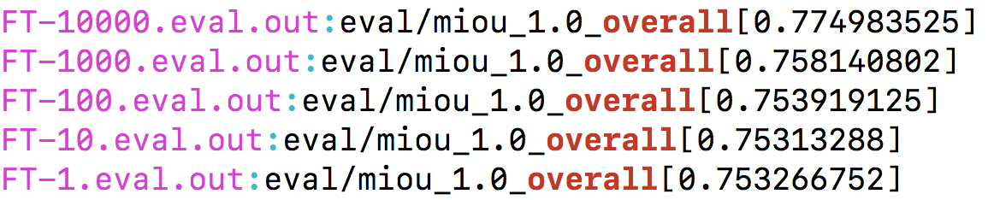
Prep for Full 32-bit Float Models for Post-Quantization
Train from scratch mIOU 3.4% w/ PASCAL dataset; must need extra COCO augmented dataset
Overall mIOU improves as increase of iterations of Fine-Tuning FT)

Slide 44
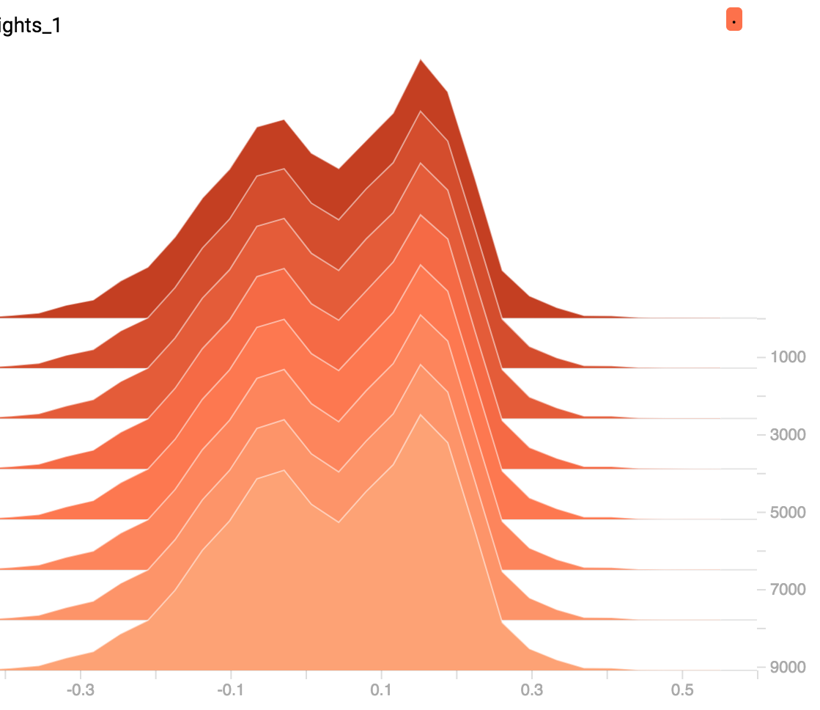
Logit Weights Distribution from Fine-Tuning (32-bit model)
32-bit Float range --> quantized 8-bit integer

Slide 45
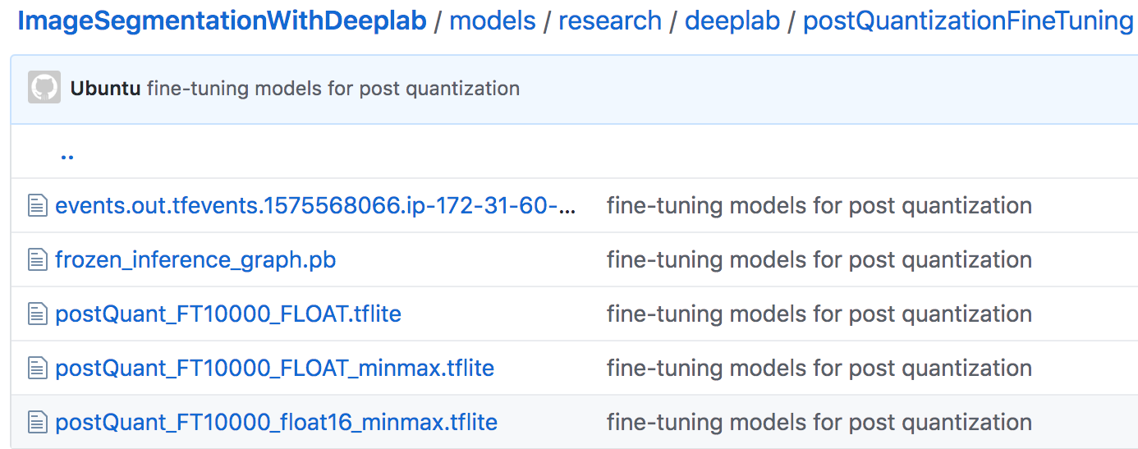
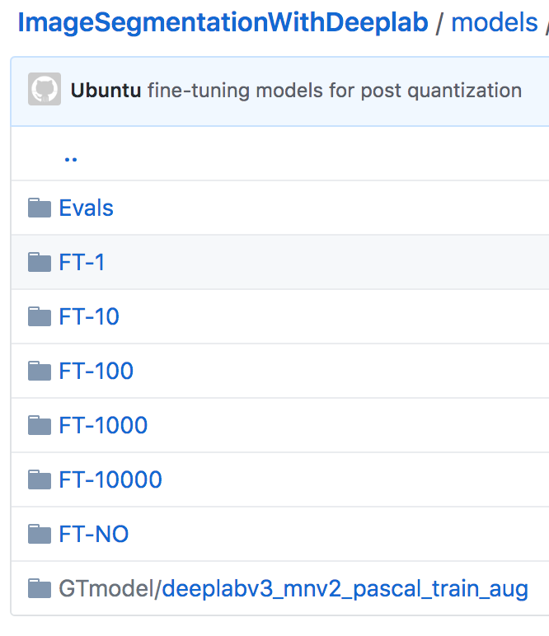
Quantization Models / Script https://github.com/SherifSabri/ImageSegmentationWithDeeplab
Full 32-bit
Quantized-8bit
Quantized-16bit

Slide 46
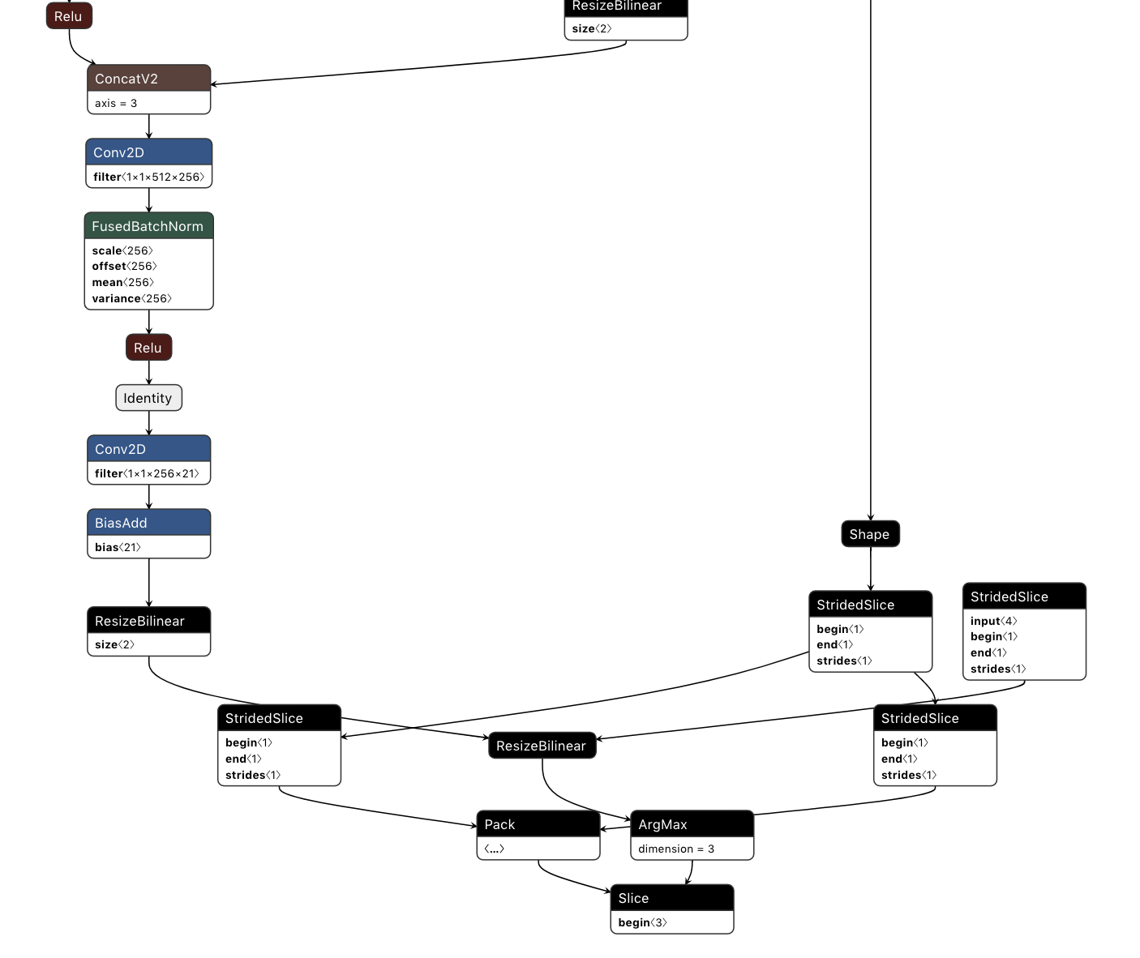
Tensorflow Graph prior to Quantization (float32)

Slide 47
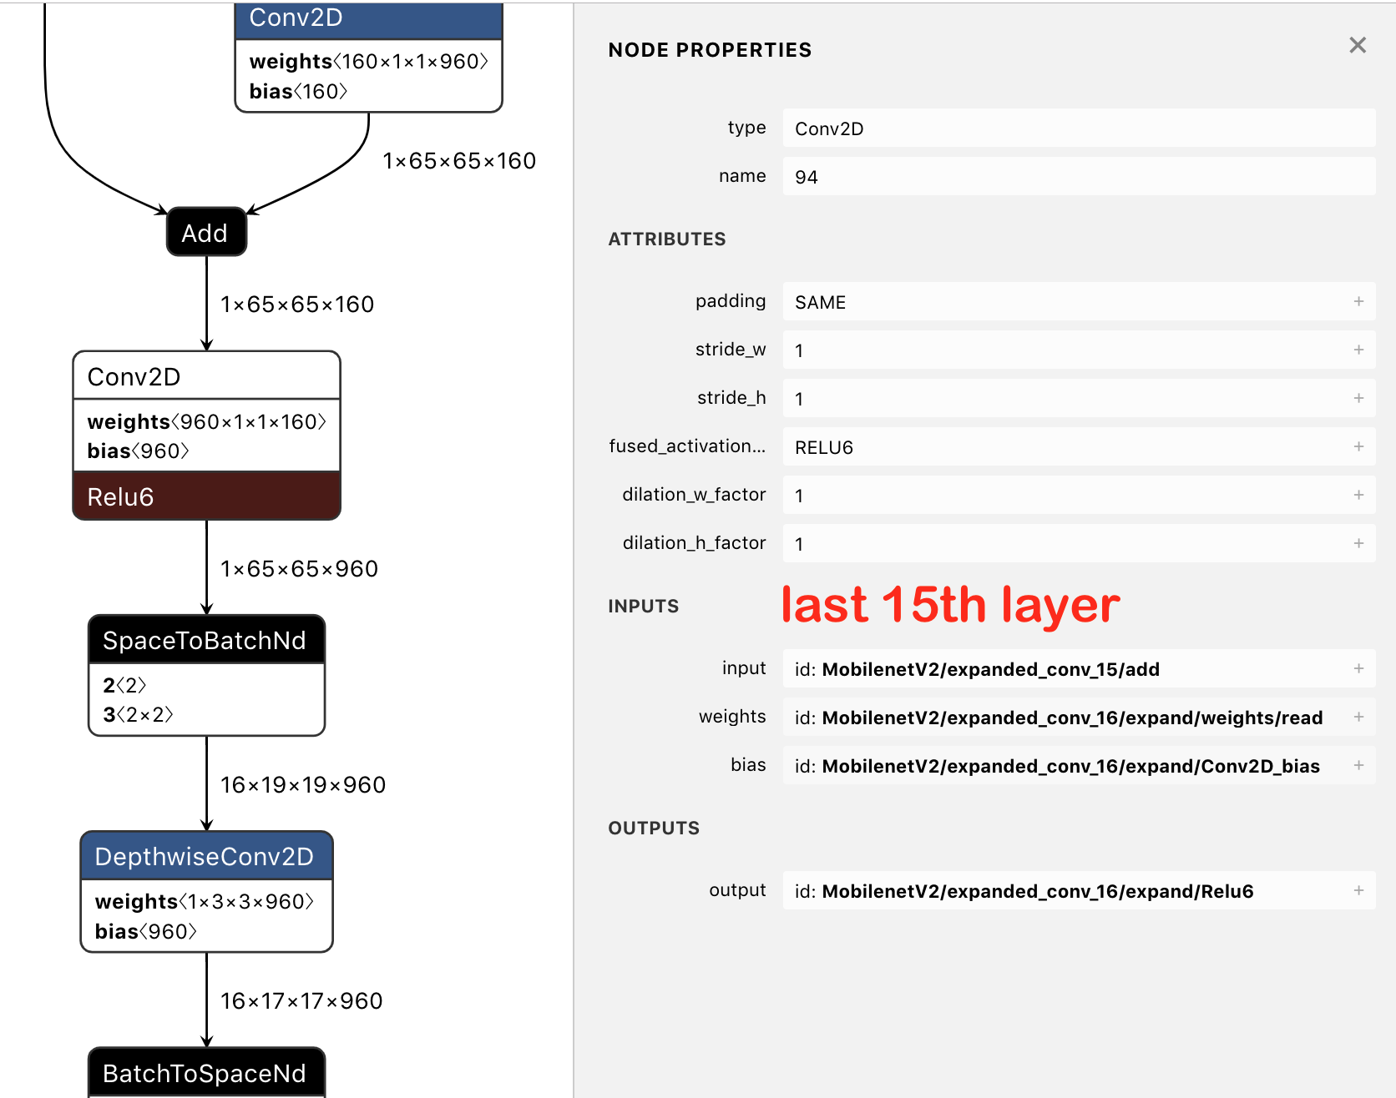
Quantized Graph (16-bit int) :
Almost same size as f32;
but operations are pruned

Slide 48
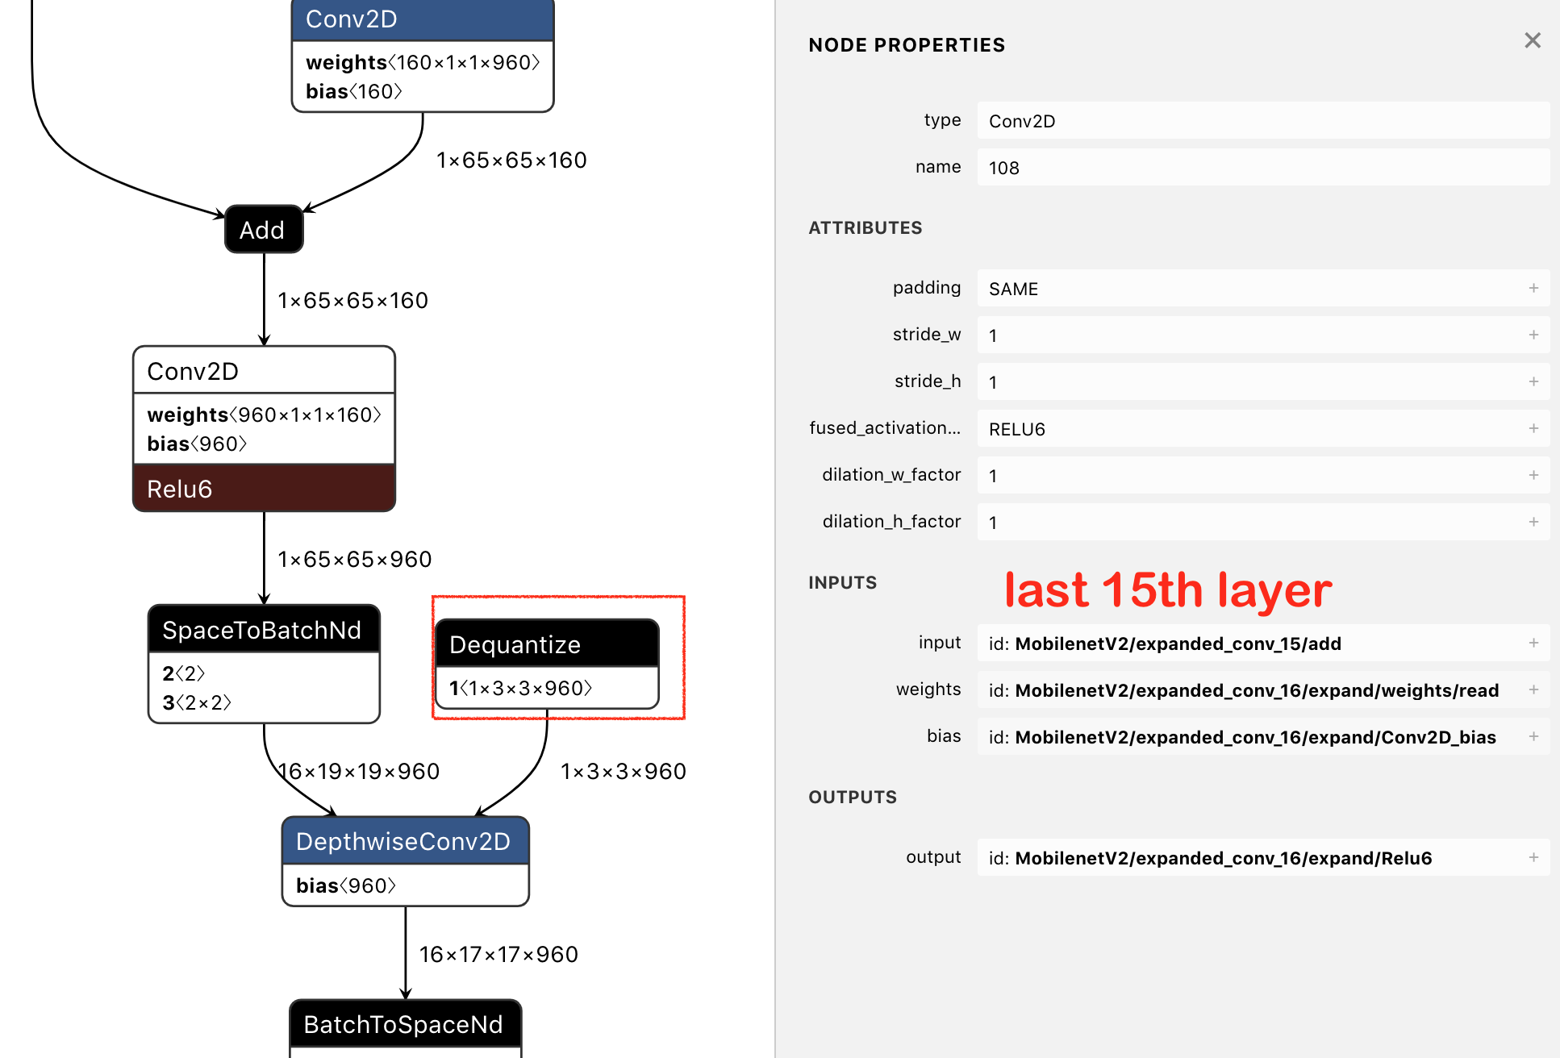
Quantized Graph (8-bit int) :
¼ size reduction; dequantization for intermediate operations

Slide 49
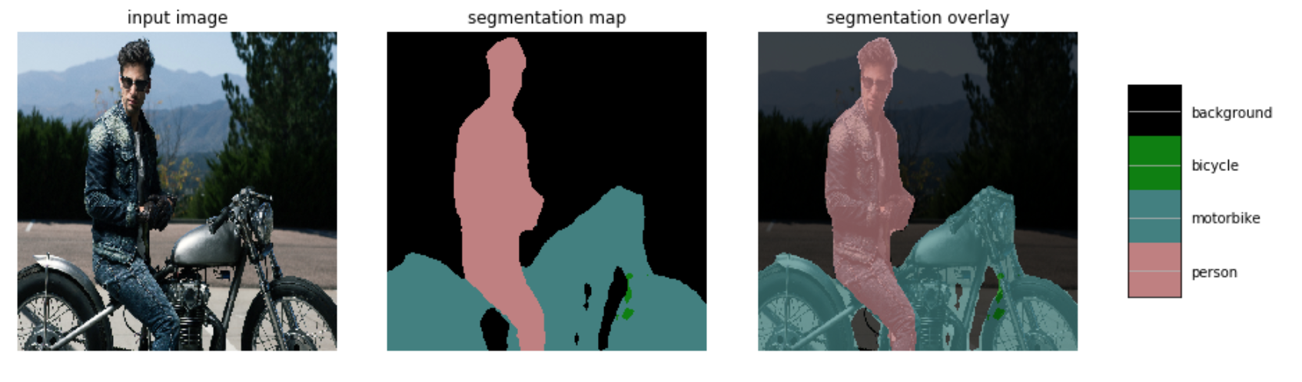
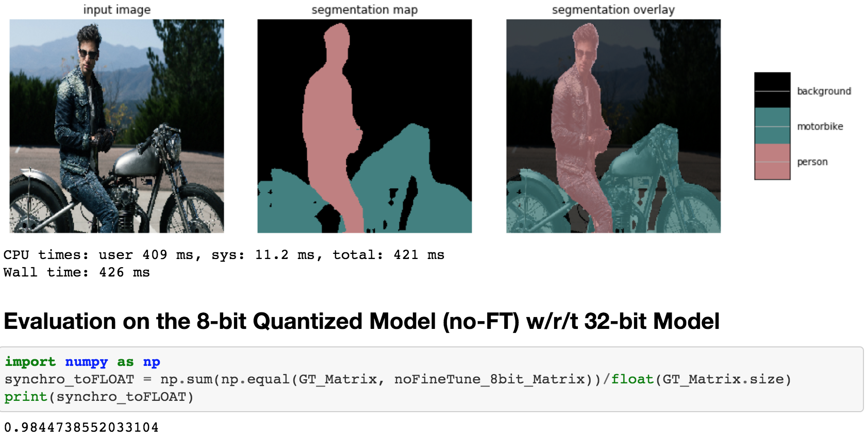
Evaluation
Ref: 32-bit inference
-------------
8-bit int
Quantized
Size: 8.4M→ 2.1M IOU: 98% similar
Latency: 2.46s → 427ms (5.8 faster)

Slide 50
Evaluation on Post Quantization Models w/r/t float32 Model
Model | Size (MB) | Latency (ms) Walltime | IOU w/r/t 32-bit Inference
32-bit float | 8.4 | 2460 | 1.0
8-bit int (no-FT) | 2.1 (1/4) | 427 (x 5.76 faster) | 0.9844
16-bit int (no-FT) | 8.1 | 440 (x 5.59 faster) | 0.9875
8-bit int (10K-FT) | 2.1 (1/4) | 436 (x 5.64 faster) | 0.9714
16-bit int (10K-FT) | 8.1 | 441 (x 5.58 faster) | 0.9779

Slide 51
6. Quantization Approach 2 -- Quantization-Aware-Training
=> F32 model prep -> Quantize

Slide 52
Why ?
Float 32 Model - Forward pass - training / inference - full float precision computation
Quantized Mode - Forward pass - inference - integer precision
Loss in accuracy
In a quantized model, no way to make up for this loss.
Notes:
In a float 32 model, computations during forward pass are performed in full precision
In a quantized model, computation are effectively performed on integer values.
This causes loss in precision
In practice there

Slide 53
Quantization Aware Training (QAT)
Simulate quantization during training
Perform computations on rounded weight values

Slide 54
Quantization Aware Training (QAT)
Simulate quantization during training
Perform rounded computations
Fake quantization nodes
Capture the activation range of each layer
Perform quantized computations
Note: Weights are maintained in full precision.

Slide 55
Quantization Aware Training (QAT)
Simulate quantization during training
Perform rounded computations
Fake quantization nodes
Capture the activation range of each layer
Perform quantized computations
Prepares model weights for the loss incurred by quantization.
Notes:
Prepares model weights for the loss incurred by quantization.- this is the most important distinguishing factor between PostTraining QAt nad QAT...by doing quantized computations during training itself we are updating our weights to the loss ..

Slide 56
Adding QAT Support - Tensorflow
Modification 1:
Create training Graph: tf.contrib.quantize.create_training_graph()
argument : quant_delay
Rewrites the training graph in place by adding fake quantization nodes.

Slide 57
Adding QAT Support - Tensorflow
Modification 2:
Create Evaluation Graph:
tf.contrib.quantize.create_eval_graph()
Rewrites the evaluation graph in place by adding fake quantization nodes.

Slide 58
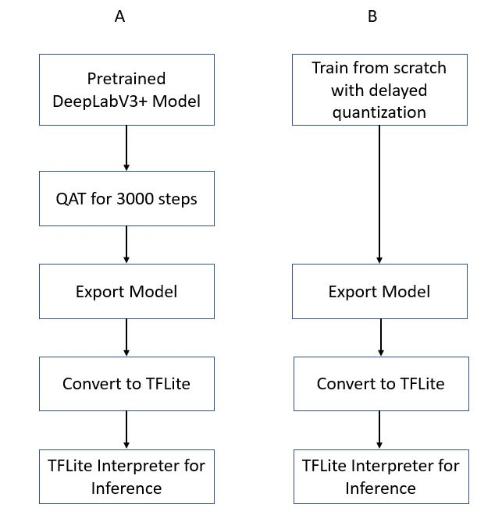
QAT - Experiments

Slide 59
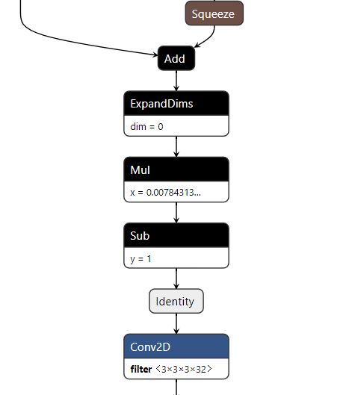
Graph Visualization
Tensorflow Graph prior to Quantization (float32)

Slide 60
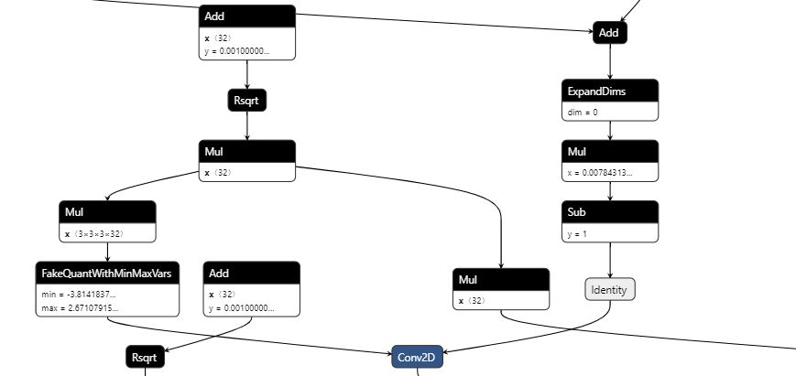
Graph Visualization
Tensorflow Graph with QAT

Slide 61
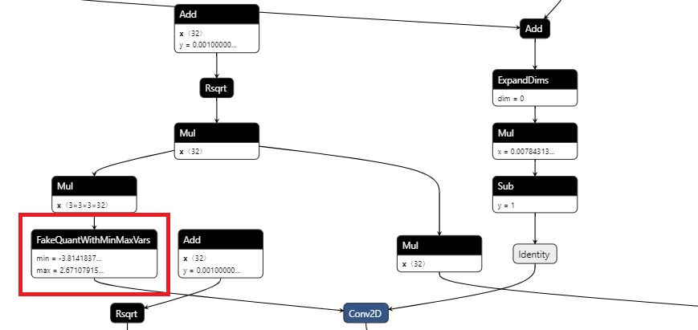
Graph Visualization
Tensorflow Graph with QAT

Slide 62
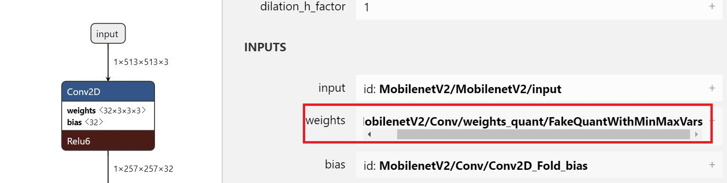
Graph Visualization TFLite Graph With Quantization
Notes:
Seems like the fake quantization nodes also save the quantized weights..and the same weight tensors are being used in TFLite model..

Slide 63
Delayed Quantization
One of the .Next items that we showcased for the final milestone
Used when training and quantization have to be performed in the same cycle.
Quantization will be delayed until the last few steps.
Controlled by the argument ‘quant_delay’ for the function

Slide 64
Delayed Quantization
Trained a DeeplapV3+ model from scratch with the following parameters
python train.py
--training_number_of_steps=36000
--quantize_delay_step=30000
--base_learning_rate=0.0001

Slide 65
7. Inference and Evaluation with
Demo (Quantization/Inference)
=> Comparison between F32 vs. 8-bit integer inferences

Slide 66
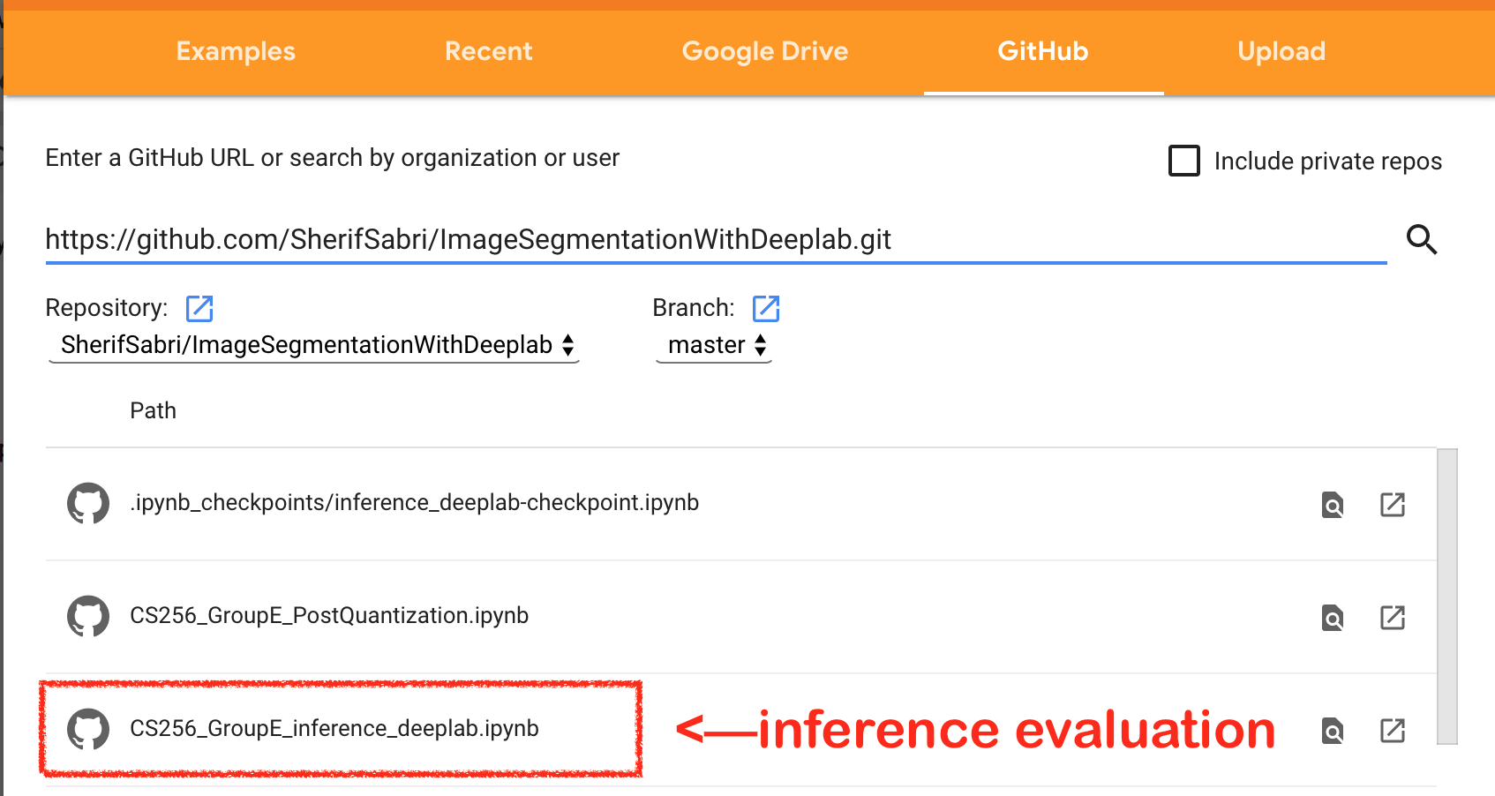
Demo on the Colab by Searching our GitHub
https://github.com/SherifSabri/ImageSegmentationWithDeeplab
CS256-GroupE_inference_deeplab.ipynb

Slide 67
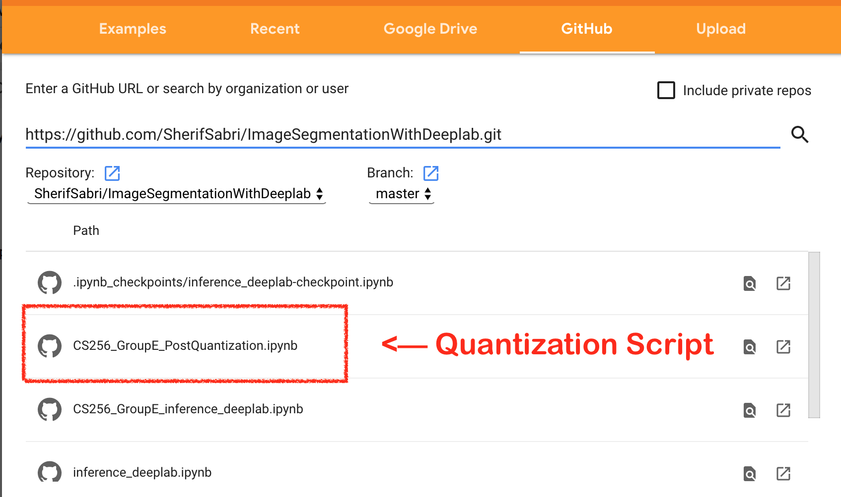
Post-Training Quantization Script is available
https://github.com/SherifSabri/ImageSegmentationWithDeeplab
CS256-GroupE_PostQuantization.ipynb

Slide 68
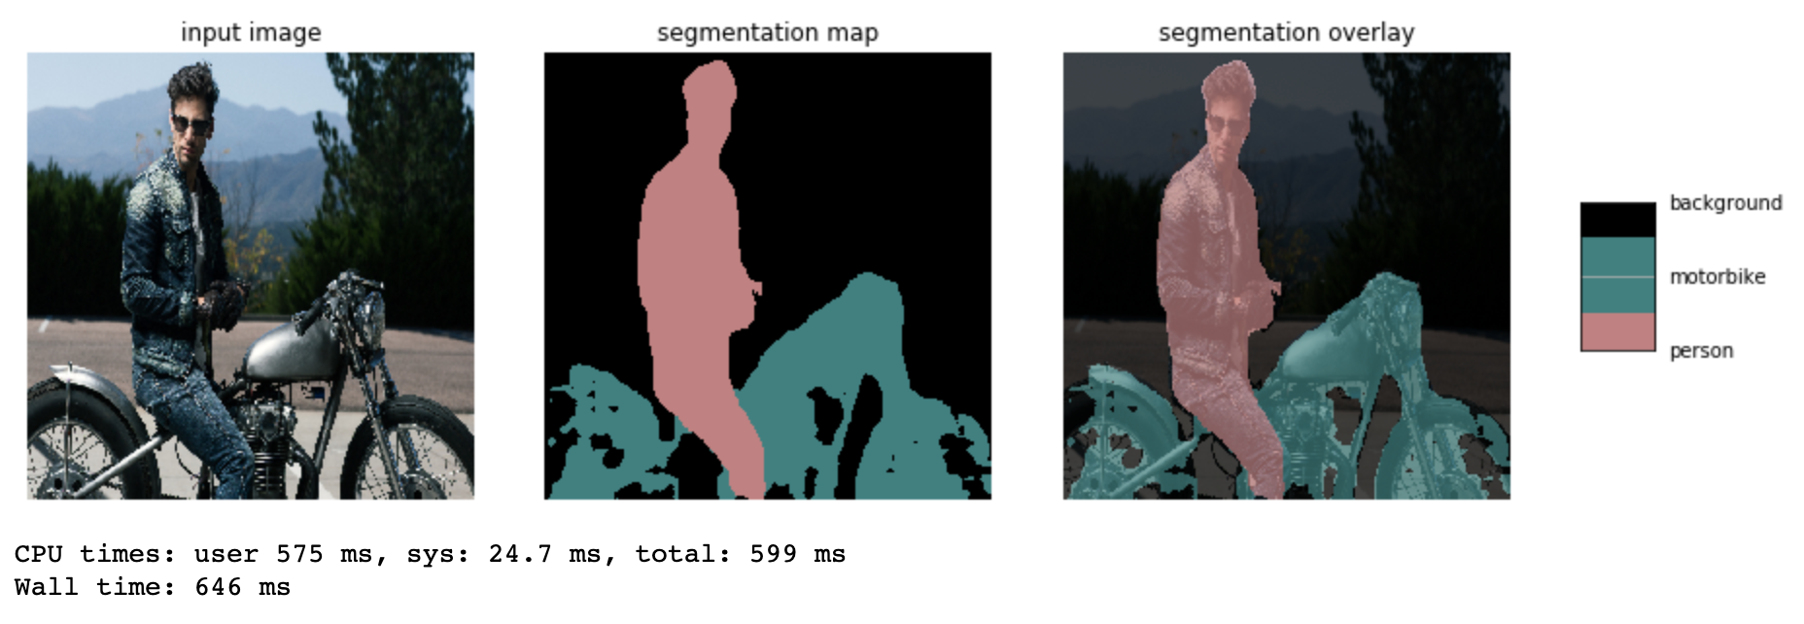

Comparison with Deeplab authors provided model
Comparable results both in accuracy and inference time

Slide 69
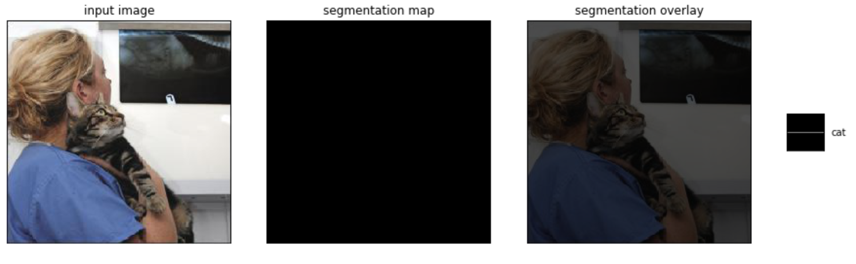
Initial Results
Failed to produce segmentation mask, and an invalid quantization field

Slide 70
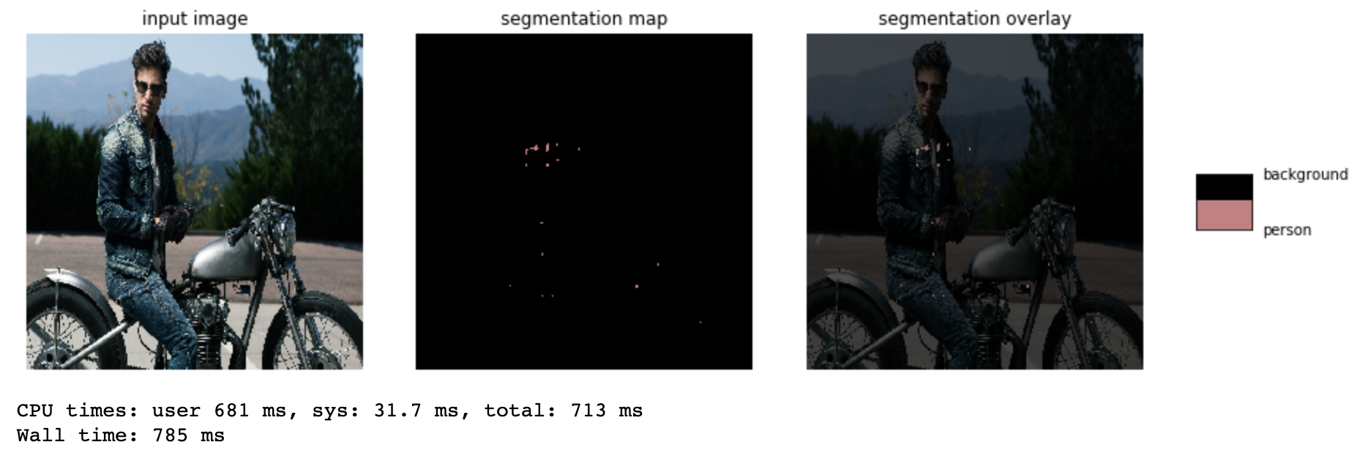
Initial Results
Still Failed to produce segmentation mask, with a valid quantization field

Slide 71
Final Results
Successful inference on quantized model

